Slide 1
Chapter 7
Random Variables: Working with Uncertain Numbers
Elsevier/Academic Press
© Andrew F. Siegel, 2016

Slide 2
Random Variable
A specification or description of a numerical result from a random experiment
  The number is the observation of the random variable
  The random variable is the meaning of the number
    The observed value is 17 for the random variable
      “Last week’s warranty returns (number of customers)”
  Examples
    Today’s stock market close
    The number of defective parts produced today
    Next quarter’s sales
  Summaries: μ = mean (expected value)
  σ = standard deviation
Elsevier/Academic Press
© Andrew F. Siegel, 2016

Slide 3
Examples of Random Variables
Random Standard
Variable Mean Deviation
X = $1.40 $1.40 $0
Y = $1.50 $0.50
Z = $1.90 $13.30
No risk
{
$1 prob 0.5
$2 prob 0.5
{
$0 prob 0.98
$95 prob 0.02
High
risk
Elsevier/Academic Press
© Andrew F. Siegel, 2016

Slide 4
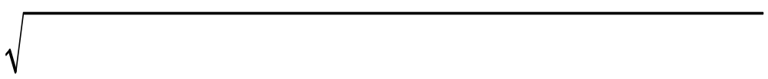
Discrete Random Variable
Can list all possible outcomes
Probability Distribution
  The list of values and probabilities. Use it to compute!
Mean (expected value) of random variable X
  μ = Sum of Value × Prob of Value = E(X) = ∑ XP(X)
    Gives a typical or central value of the random variable
Standard deviation of random variable X
  σ = Sum of (Value – μ)² × Probability of Value
  =
    Tells about how far from expected this random variable will be
∑
(
X
−
μ
)
2
P
(
X
)
Elsevier/Academic Press
© Andrew F. Siegel, 2016

Slide 5
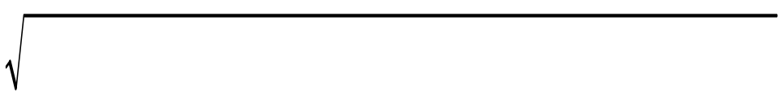
Example: Investment Payoffs
Probability distribution of investment payoffs
  μ = 0 × 0.98 + 95 × 0.02 = $1.90
    The expected payoff is $1.90
    A compromise between $0 (most of the time) and $95 (rarely)
  σ = (0–1.90)²× 0.98 + (95–1.90)²× 0.02 = $13.30
    Actual payoffs approximately $13.30 above or below expected
    A compromise between being $1.90 below average (most of the time) and $93.10 above average (rarely)
Payoff (Value) Probability
$0 0.98
$95 0.02
Elsevier/Academic Press
© Andrew F. Siegel, 2016

Slide 6
Example: Profit Scenarios
Fig 7.1.1
Scenario Profit ($millions) Probability
Great
Good
OK
Lousy
$10
5
1
–4
0.20
0.40
0.25
0.15
0.5
Good
0.4
0.3
OK
Great
Probability
Lousy
0.2
0.1
0.0
-5
0
5
10
Profit ($millions)
Standard deviation:
$4.40 million
Expected profit: $3.65 million
Elsevier/Academic Press
© Andrew F. Siegel, 2016

Slide 7
Example (continued)
Fig 7.1.1
Probability of profit larger than $3 million
  is 0.40 + 0.20 = 0.60
  using the table values larger than $3 million
Probability of loss is simply 0.15
  There is only one loss in the table (profit of −4 million)
Scenario Profit ($millions) Probability
Great
Good
OK
Lousy
$10
5
1
–4
0.20
0.40
0.25
0.15
Elsevier/Academic Press
© Andrew F. Siegel, 2016

Slide 8
Binomial Distribution
A special type of discrete random variable
    e.g., Interview 50 random customers
      How many like the new product? 0, 1, 2, …, 49, or 50
    e.g., What percent of stocks went up yesterday?
X is binomial if it is the number of occurrences of some event, out of n trials, provided that
    The probability π is the same for all trials, and
    The trials are independent of one another
      so that each trial brings new, independent information
Binomial proportion or percent: p = X/n
    This is the relative frequency of the event
    e.g., if X = 35 of n = 50 people like product, p = 35/50 = 0.70
Elsevier/Academic Press
© Andrew F. Siegel, 2016

Slide 9
Binomial Probabilities
A discrete distribution
  Skewed if π is close to 0
  Symmetric if π is 0.5 (or close)
    Approximately normal
  Skewed if π is close to 1
0.4
π = 0.05, n = 25
0.2
0
0
5
10
15
20
25
0.3
π = 0.5, n = 25
0.2
0.1
0
0
5
10
15
20
25
0.3
π = 0.9, n = 25
0.2
0.1
0
0
5
10
15
20
25
Elsevier/Academic Press
© Andrew F. Siegel, 2016

Slide 10

Binomial Mean and Std. Deviation
Shortcut to find mean and standard deviation quickly for binomial random variables (X or p)
  No need to compute the probability distribution
    work directly from n and π
Mean
Std. Dev.
Number of
Occurrences, X
μ_{X} = nπ
σ_{X} = nπ(1–π)
Proportion or
Percent, p = X/n
μ_{p} = π
σ_{p} = π(1–π)/n
Elsevier/Academic Press
© Andrew F. Siegel, 2016

Slide 11




Example: Sampling Defective Parts
Draw a random sample of n = 200 from the day’s production
  Suppose that π = 7% of this production is defective
Mean
Std. Dev.
Number of
Defects, X
μ_{X} = nπ
= 200×0.07 = 14
“Expect to see 14
defects, on average”
σ_{X} = nπ(1–π)
= 200×0.07×0.93
= 3.61
“Typically expect approx.
3.61 more or less than 14”
Proportion or Percent
Defective, p = X/n
μ_{p} = π = 0.07
“Expect to see 7%
defective, on average”
σ_{p} = π(1–π)/n
= 0.07×0.93/200
= 0.018
“Typically expect approx.
1.8% more or less than 7%”
Percentage
points
Elsevier/Academic Press
© Andrew F. Siegel, 2016

Slide 12
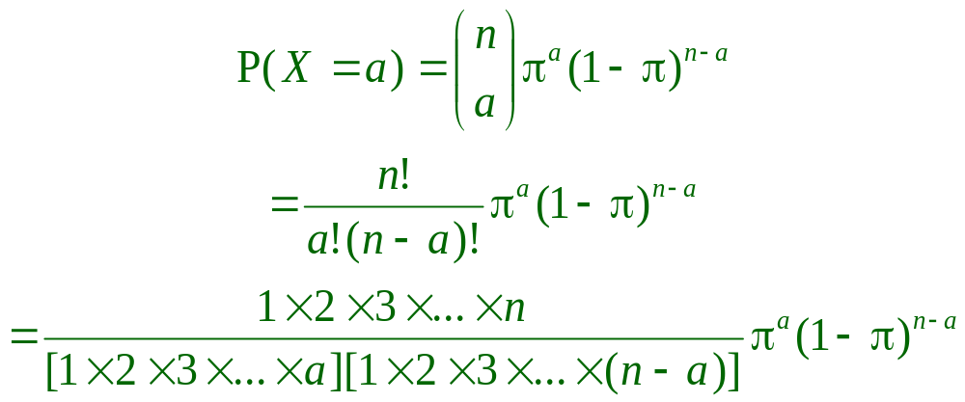
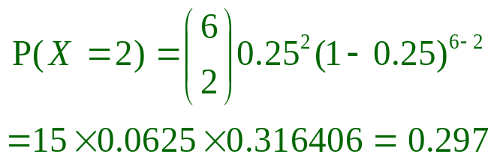
Computing Binomial Probabilities
Binomial probability that X equals a
  Example: probability that exactly a = 2 of your n = 6 major customers will call tomorrow (assuming that
  π = 0.25 is the probability that each one will call)
    0.297 from computer calculation of this formula:
  Using Excel® =BINOMDIST(2,6,0.25,FALSE)
Elsevier/Academic Press
© Andrew F. Siegel, 2016

Slide 13
Normal Distribution
A special continuous distribution (not discrete)
For every mean μ and (positive) standard deviation σ there is a normal distribution
  The mean μ moves the curve left and right
  The standard deviation σ widens and narrows the curve
σ
σ
μ
Elsevier/Academic Press
© Andrew F. Siegel, 2016

Slide 14
Probability: Area Under the Curve
Probability of observing a value between a and b is area under the curve
Note: total area = 1
More likely
Less likely
a
b
a
b
Probability = 0.50
Probability = 0.68
(one std. dev.)
Probability = 0.95
(two std. devs.)
σ
σ
σ
σ
μ
μ
Elsevier/Academic Press
© Andrew F. Siegel, 2016

Slide 15
Standard Normal Distribution
Normal with mean μ = 0 and std. deviation σ = 1
Standard normal probability table
  Gives probability that a standard normal is less than a given value
-3
-2
-1
0
1
2
3
Examples
Probability
= 0.3085
Value
Probability
–1
0
1
2
0.1587
0.5
0.8413
0.9772
1 – 0.1587
= 0.8413
-3
-2
-1
0
1
2
3
Value = – 0.5
Excel®:
=NORMSDIST(2)
Elsevier/Academic Press
© Andrew F. Siegel, 2016

Slide 16
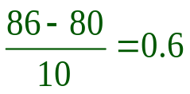
Finding Normal Probabilities
Example: Sales are forecast as $80 million (mean) with a standard deviation of $10 million. Find the probability that sales will exceed $86 million, assuming a normal distribution
  Figure out the question
    Find Prob(X > 86) where μ = 80 and σ = 10
  Answer: 0.274
  e.g., using Excel® =1-normdist(86,80,10,TRUE)
  Picture:
This is prob
of being more
than 0.60 SD
above the mean
Sales
$50
$60
$70
$80
$90
$100
$110
$
-3
-2
-1
0
1
2
3
SDs from mean
$86 is
0.60 SD above mean
Elsevier/Academic Press
© Andrew F. Siegel, 2016

Slide 17


Normal Approx. to the Binomial
Part of a general result: The normal distribution often appears as a limit (central limit theorem)
If
  • n is large, and
  • π is not too close to 0 or 1,
Then
  Binomial probabilities for X are close to normal probabilities with
    • μ = μ_{X} = nπ • σ = σ_{X} = nπ(1–π)
  Similarly for p=X/n with
    • μ = μ_{p} = π • σ = σ_{p} = π(1–π)/n
Elsevier/Academic Press
© Andrew F. Siegel, 2016

Slide 18

Example: an Opinion Poll
Suppose π = 55% approve president’s performance
  We interview n = 400 chosen at random
  What are the chances that fewer than 200 will say they approve? That is, find Prob (X < 200)
    When you round any number less than 199.5 to the nearest whole number, the result will be “fewer than 200”
    The mean is μ_{X} = nπ = 400×0.55 = 220
    The standard deviation is σ_{X} = nπ(1–π) = 9.9499
    Approximation: we could compute the probability that a normal random variable with this mean and this standard deviation is less than 199.5, about 2 SD below the mean.
    Prob = Prob = 0.0197
    Compare to exact answer 0.0199
(
X – μ_{X}
199.5 – 220
)
(
Standard
)
<
normal
< –2.06
σ
9.9499
Elsevier/Academic Press
© Andrew F. Siegel, 2016

Slide 19
Example: Poll (continued)
Still assuming 55% approve and we interview 400 at random
  What are the chances more than 58% will say they approve?
    Convert from percentage p to number of people X
    Note that 58% of 400 people is 0.58 × 400 = 232 people
    Numbers that round to “more than 232” are 232.5 and above
    Approximation: we could compute the probability that a normal random variable with mean μ_{X} = 220 and standard deviation σ_{X} = 9.9499 is more than 232.5, just over one SD above the mean
    Prob = Prob = 0.104
    About 10% of the time we will find more than 58%
    Compare to exact answer 0.104 (approximate 0.1038, exact 0.1042)
(
X – μ_{X}
232.5 – 220
)
(
Standard
)
>
normal
> 1.26
σ
9.9499
Elsevier/Academic Press
© Andrew F. Siegel, 2016

Slide 20
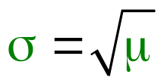
Poisson Distribution
A discrete random variable
A model for # occurrences in a fixed time interval
  where occurrences are independent at mean rate μ.
Examples: • # orders received tomorrow, • # phone calls next hour, • # customer returns next week
Sample space of possible values is {0, 1, 2, ...}
Standard deviation is
If large μ, then the Poisson is approximately normal
Approximately Poisson: Binomial with small π & large n
Elsevier/Academic Press
© Andrew F. Siegel, 2016

Slide 21
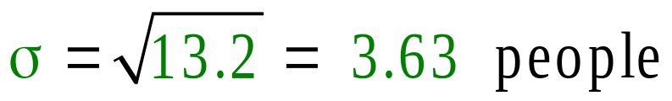
Poisson Distribution (continued)
If mean is that 13.2 people arrive, then:
  Standard deviation is
  Probability that more than 18 people arrive is 0.0781
  using the computer
  Probability that the number of people arriving is between 10 and 16 inclusive is 0.668
    which seems about right for being within about one standard deviation from the mean
Elsevier/Academic Press
© Andrew F. Siegel, 2016

Slide 22
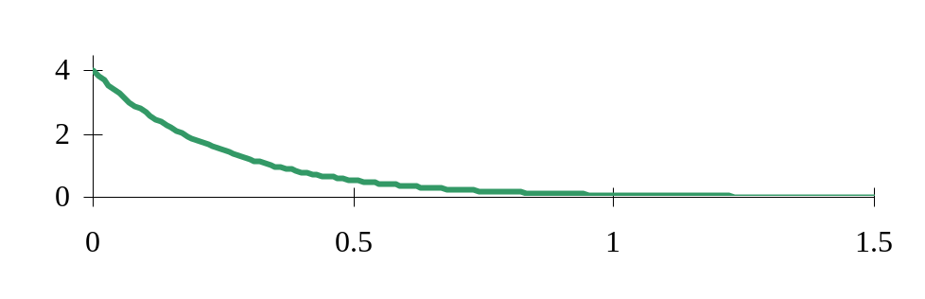

Exponential Distribution
A continuous random variable that is very skewed
  Always the same shape
A model for waiting times
  until the next Poisson event, again assuming independent occurrences at constant rate.
Examples: • time until next order, • time between orders, • duration of phone calls, ...
Sample space is all numbers that are ≥ 0 (e.g., 3.87, 10.46)
Standard deviation equals the mean:
Has no memory. Always same wait for next occurrence
  regardless of what just happened!
Elsevier/Academic Press
© Andrew F. Siegel, 2016

Slide 23

Exponential Distribution (continued)
If mean waiting time is 28.6 minutes, then:
  Standard deviation is also
  Probability of waiting more than 20 minutes is 0.497
  using the computer
  Probability of waiting between 0 and 56 minutes
  is 0.859
    which seems large for being within about one standard deviation from the mean, due to skewness
Elsevier/Academic Press
© Andrew F. Siegel, 2016

